Slide 1
Which are the correct barcode sequences of my NGS Illumina libraries?

Slide 2
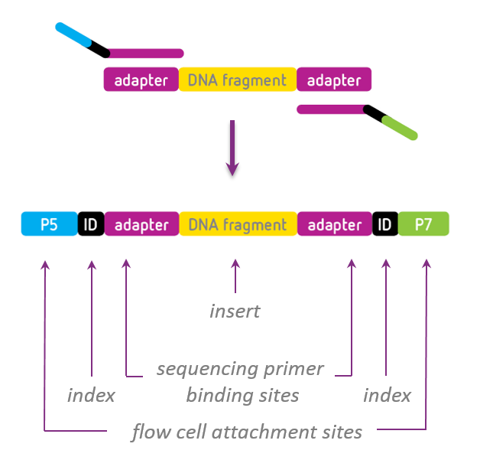
Illumina Sequencing Library construct

Slide 3
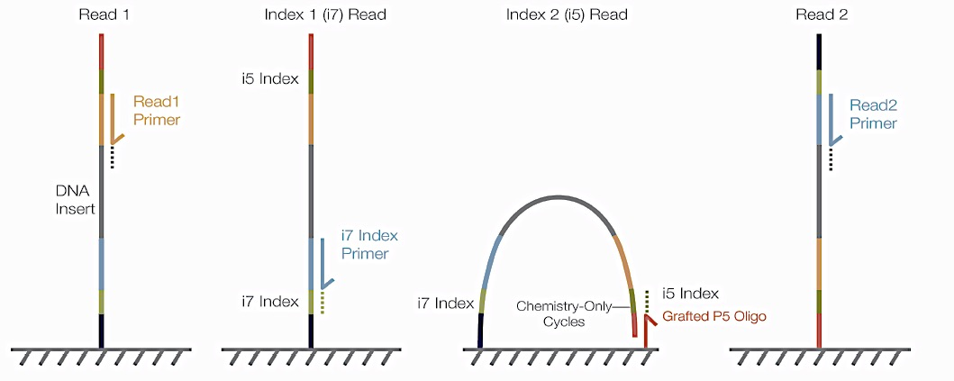
How are the index reads performed?
P5
P7
Index1 (i7) Read: reverse complement of the barcode region (ID) in P7 + adapter
Index2 (i5) Read: barcode region (ID) in P5 + adapter
Some Illumina sequencers read Index2 different. We automatically correct the barcodes for the different mode. Always provide the index2 barcode which is specified for NovaSeq,MiSeq,HiSeq 2000/2500 (even in the case that your libraries are running on a different instrument)

Slide 4
Example
Barcode Region
P7+Adapter:
5’- CAAGCAGAAGACGGCATACGAGAT[CGTGAT]GTCTCGTGGGCTCGG
Barcode Sequence for Index1: ATCACG
P5+Adapter:
5’- AATGATACGGCGACCACCGAGATCTACAC[CAGGACGT]TCGTCGGCAGCGTC
Barcode Sequence for Index2: CAGGACGT

Slide 5
Summary
Provide barcode sequences as indicated in your library prep kit
For index2 always provide the sequence specific for NovaSeq, MiSeq, HiSeq 2000/2500
In case of custom primers please check carefully for the correct orientation

