Slide 1
ENA Submission Guide

Slide 2
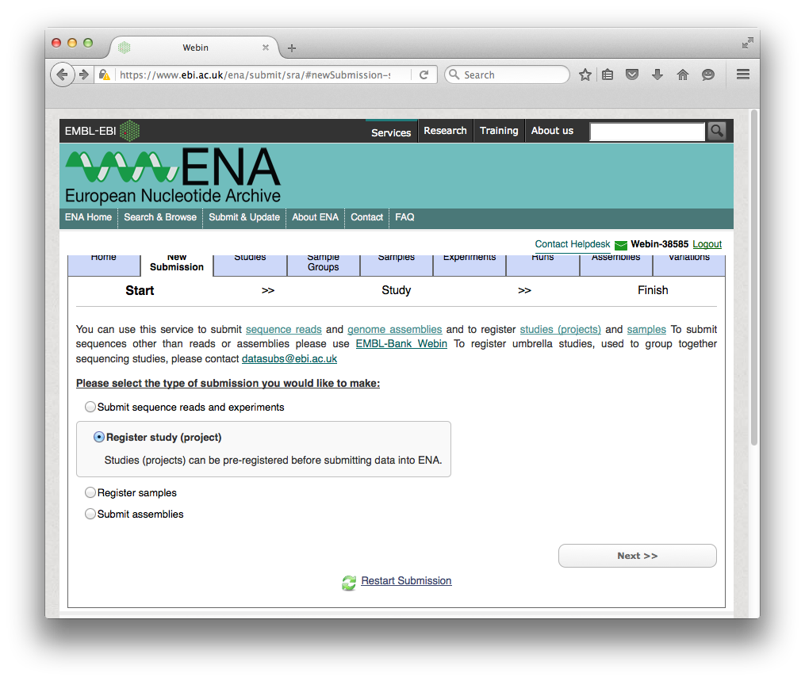
https://www.ebi.ac.uk/ena/submit/sra/#newSubmission-studyChoice-start
Create a New Submission
And Register Study

Slide 3
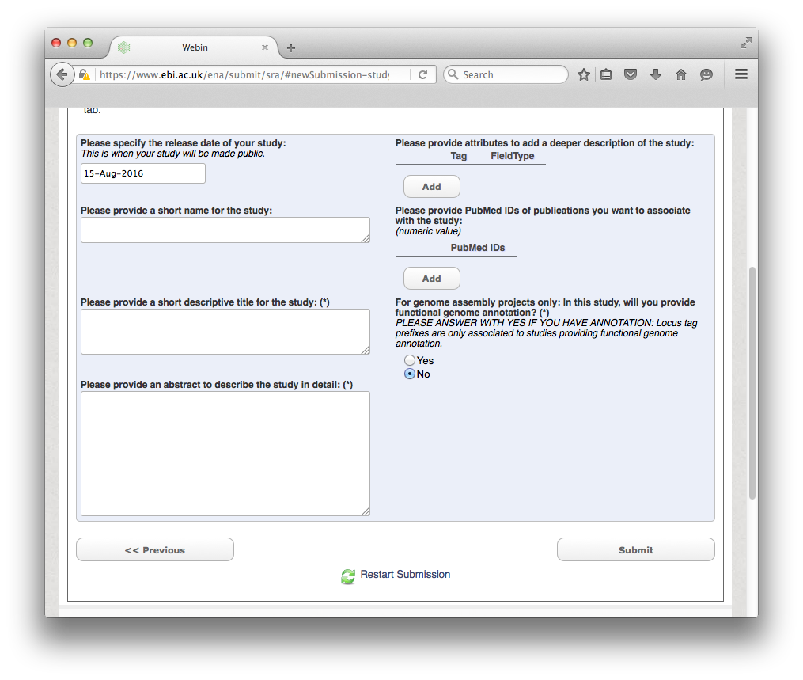
Provide the project description and submit
Then you will already have a study accession that you can add as reference to your manuscript

Slide 4
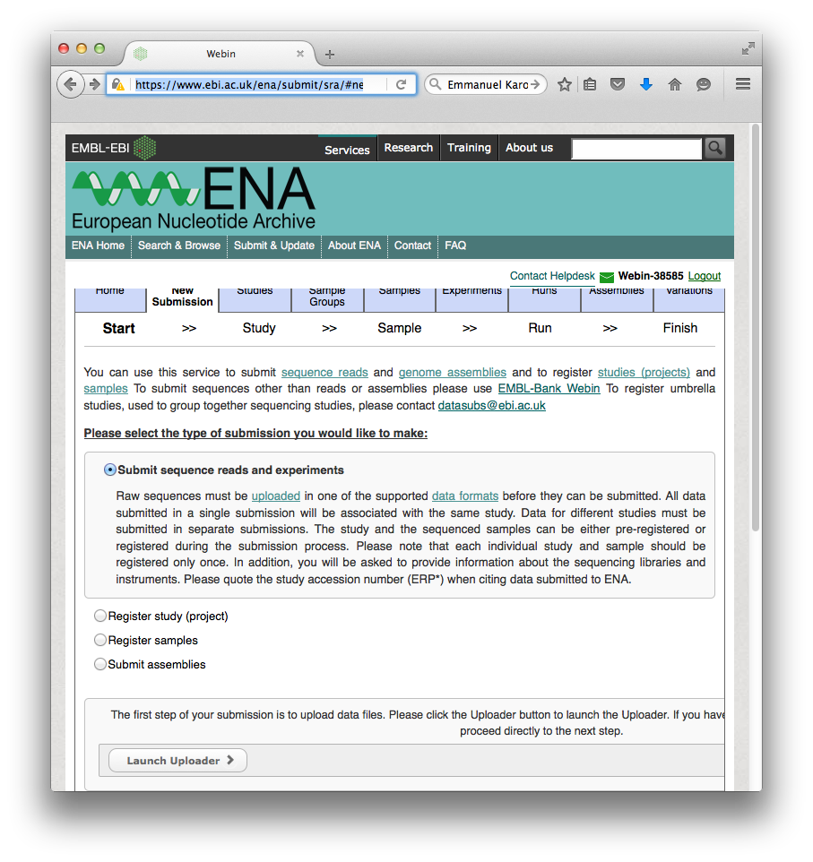
https://www.ebi.ac.uk/ena/submit/sra/#newSubmission-sequenceChoice-start
Now Submit sequence reads ..
Click Next
Do not launch the uploader

Slide 5
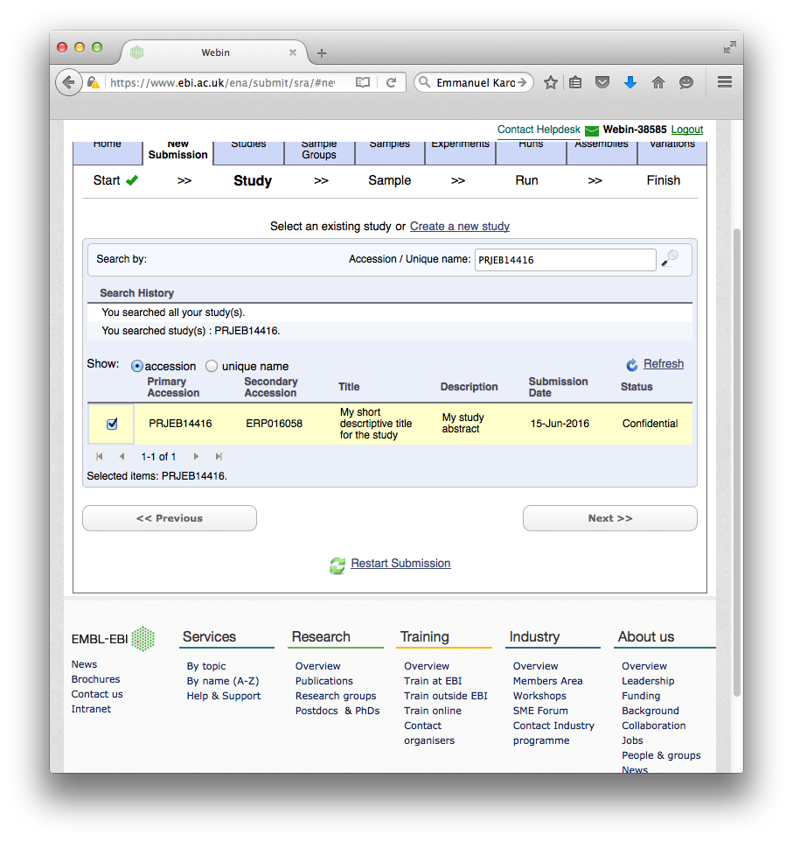
Select the study to which you want to add the reads
Click next

Slide 6
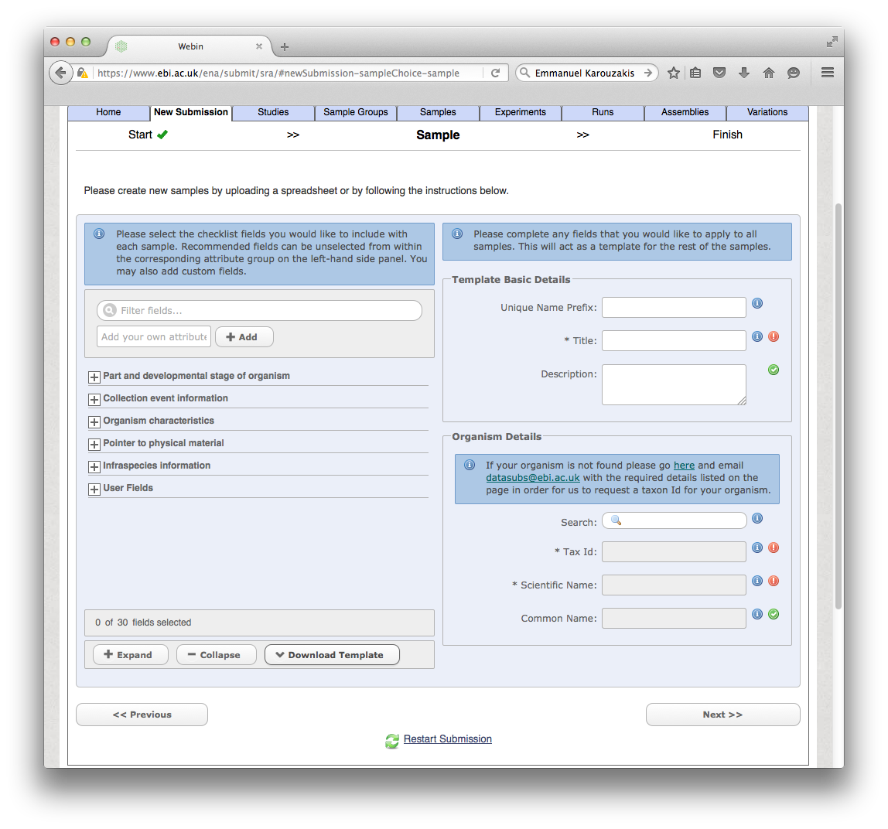
Download the Excel Template for the Samples

Slide 7
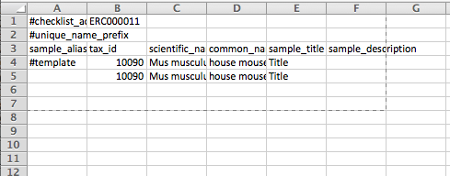
Example for the minimum Excel template:
You can add additional columns if wanted
Upload the spread sheet.

Slide 8
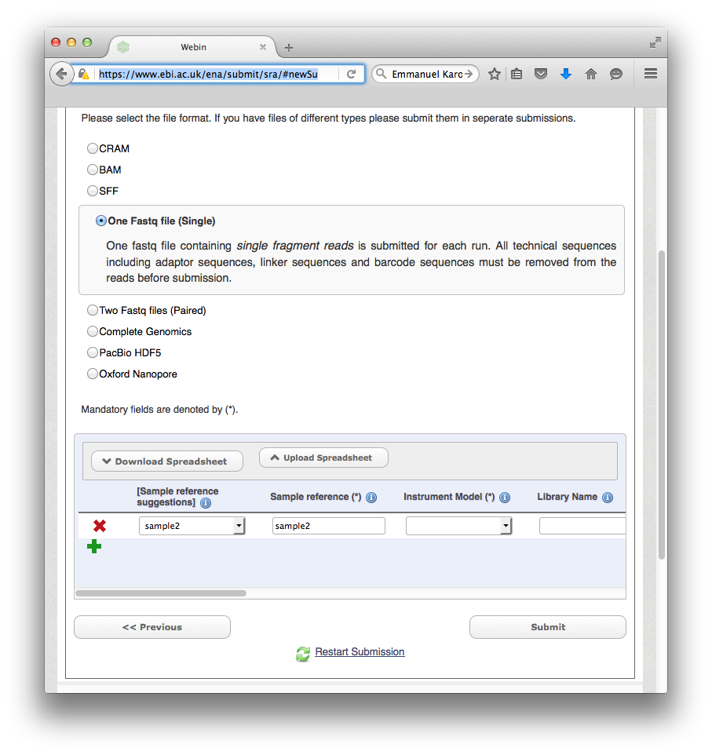
https://www.ebi.ac.uk/ena/submit/sra/#newSubmission-sequenceChoice-runExperiment
Finally you can select the samples with the selection boxes
Then you Download Spreadsheet
In the downloaded template you can add the filenames of the fastq files and the MD5 sums
Upload Spreadsheet
Done

